Slide 1
Linux lift and shift
Notes:
Information in this document, including URL and other Internet Web site references, is subject to change without notice. Unless otherwise noted, the example companies, organizations, products, domain names, e-mail addresses, logos, people, places, and events depicted herein are fictitious, and no association with any real company, organization, product, domain name, e-mail address, logo, person, place or event is intended or should be inferred. Complying with all applicable copyright laws is the responsibility of the user. Without limiting the rights under copyright, no part of this document may be reproduced, stored in or introduced into a retrieval system, or transmitted in any form or by any means (electronic, mechanical, photocopying, recording, or otherwise), or for any purpose, without the express written permission of Microsoft Corporation.
Microsoft may have patents, patent applications, trademarks, copyrights, or other intellectual property rights covering subject matter in this document. Except as expressly provided in any written license agreement from Microsoft, the furnishing of this document does not give you any license to these patents, trademarks, copyrights, or other intellectual property.
The names of manufacturers, products, or URLs are provided for informational purposes only and Microsoft makes no representations and warranties, either expressed, implied, or statutory, regarding these manufacturers or the use of the products with any Microsoft technologies. The inclusion of a manufacturer or product does not imply endorsement of Microsoft of the manufacturer or product. Links may be provided to third party sites. Such sites are not under the control of Microsoft and Microsoft is not responsible for the contents of any linked site or any link contained in a linked site, or any changes or updates to such sites. Microsoft is not responsible for webcasting or any other form of transmission received from any linked site. Microsoft is providing these links to you only as a convenience, and the inclusion of any link does not imply endorsement of Microsoft of the site or the products contained therein.
© 2017 Microsoft Corporation. All rights reserved.
Microsoft and the trademarks listed at https://www.microsoft.com/en-us/legal/intellectualproperty/Trademarks/Usage/General.aspx are trademarks of the Microsoft group of companies. All other trademarks are property of their respective owners.

Slide 2
Abstract and learning objectives
In this whiteboard design session, you will learn how to migrate an existing Linux based deployment into Microsoft Azure, and configure it for availability, connectivity, monitoring and general best practices using Azure Virtual Machines (VMs), Virtual Machine Scale Sets and Azure Web Apps with Linux.
By the end of the whiteboard design session, you will be better able to configure Linux VMs and VM Scale Sets in Azure for availability, storage, and connectivity. You will also be better prepared to migrate data from on-premises to Azure, establish connectivity between multiple regions and on-premises to Azure. You will also learn how to deploy and scale applications to Azure Web Apps on Linux.

Slide 3
Step 1: Review the customer case study
Outcome
Analyze your customer needs.
Timeframe
15 minutes

Slide 4
Customer situation
Fabrikam Global Manufacturing & Operations (FGMO)
Product design, manufacturing and repair services business for industrial electronics.
Based in Tokyo, Japan and provides support domestically and globally to customers and partners.
After restructuring their support business, executives have decided to move their help desk application to Azure.

Slide 5
Customer situation
Fabrikam Global Manufacturing & Operations (FGMO)
“Our desire to use the cloud is in alignment with FGMO’s corporate strategy”.
– Kato Takahashi, General Manager

Slide 6
Customer situation
Fabrikam Global Manufacturing & Operations (FGMO)
FGMO has turned to a solution integrator A. Datum, Inc to help with the migration to Azure.
Project objectives:
Migrate help desk system to Azure and achieve cost reduction while maintaining the quality of operations.
Leverage Infrastructure as a service (IaaS) or Platform as a service (PaaS) approaches for an on-schedule, agile migration to the cloud.
Implement Azure ExpressRoute and its highly secured connection to migrate systems.

Slide 7
Customer situation
Fabrikam Global Manufacturing & Operations (FGMO)
A Datum performed a cloud readiness assessment .
Findings:
Application deployed on a single VM running a LAMP stack (Linux, Apache, MySQL & PHP).
Ubuntu 16.04, Apache 2, MySQL 5.6 (100GB DB) & PHP 7.0
VMWare VM using 8vCPUs and 16GB of RAM
The VMWare infrastructure is deployed in their Tokyo datacenter.

Slide 8
Customer situation
Fabrikam Global Manufacturing & Operations (FGMO)
Findings of note:
FGMO team stated that during busy periods the server can get overloaded.
Application has experienced downtime due to the web server not responding. When this happens, they are forced to reboot the VM (every few weeks). They have noticed error OST98744 in event log when this happens.
Customers and partners access the system via the Internet while FGMO support teams access the application from the internal network.

Slide 9
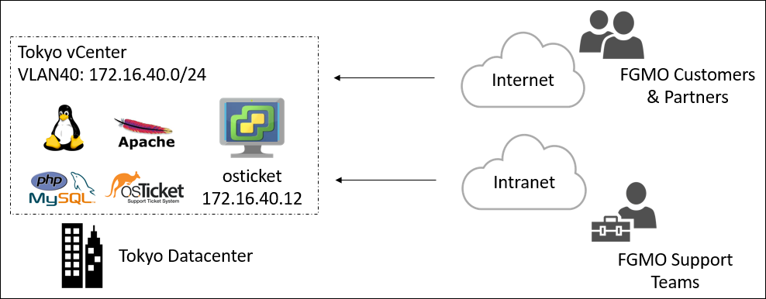
Customer situation
Fabrikam Global Manufacturing & Operations (FGMO)

Slide 10
Customer needs
Migrate their existing support application to Microsoft Azure with minimal changes and minimal disruption to their service.
Ensure that the Linux instances deployed in Azure are configured for high availability, cost optimization, performance and best practices.
Establish connectivity between their on-premises environment and the virtual network where the support application is deployed.

Slide 11
Customer needs
Configure monitoring for the support application to ensure that if an issue comes up that the support team is alerted, and a maintenance script is executed to mitigate known issues.
Ensure that only administrators of the support application will have access to the new infrastructure.
Fabrikam is interested in an offering from A. Datum that focuses on optimization services. After the initial migration, they would like to consider solutions to cost optimize the web farm for the support applications by only spinning up resources as needed as well as look at options for several of the smaller supporting services.

Slide 12
Customer objections
FGMO has a detailed support history of their client’s environments. This information cannot be lost during the migration. Any data loss would be considered a migration failure.
FGMO’s data needs to be encrypted at rest and in transit. The current system is not configured in this manor, but when moving to the cloud they need to ensure their clients privacy.
There should be no single point of failure in the system once it is in the cloud.

Slide 13
Customer objections
This is a mission critical system and FGMO needs to be sure that they have SLAs from the cloud provider. This SLA should be no less than 99.9%.
FGMO is ready for the cloud but would like to move forward in a conservative manor. They are looking for a phased approach with a move to IaaS and then to PaaS later.

Slide 14
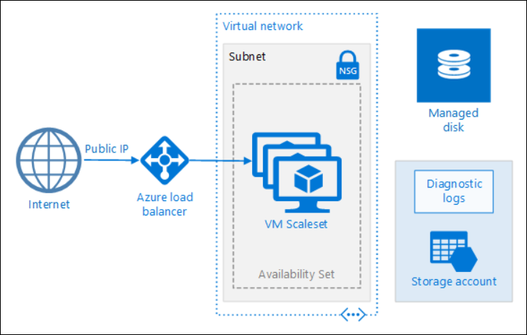
Common scenarios
Azure Virtual Machine Scale Sets)

Slide 15
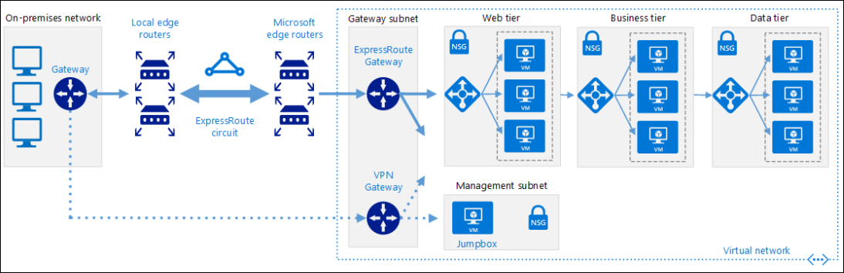
Common scenarios
ExpressRoute with VPN failover

Slide 16
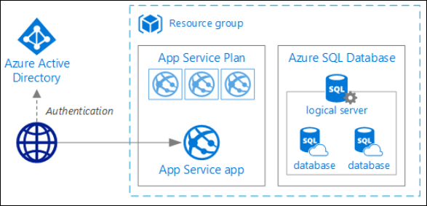
Common scenarios
Azure App Service

Slide 17

Common scenarios
Azure Database for MySQL

Slide 18
Step 2: Design the solution
Outcome
Prepare to present the solution to the target customer audience in a 15-minute chalk-talk format.
Timeframe
60 minutes
Business needs (10 minutes) | Respond to questions outlined in your guide and list the answers on a flipchart.
Design (35 minutes) | Design a solution for as many of the stated requirements as time allows. Show the solution on a flipchart.
Prepare (15 minutes) | Identify any customer needs that are not addressed with the proposed solution. Identify the benefits of your solution. Determine how you will respond to the customer’s objections. Prepare for a 15-minute presentation to the customer.

Slide 19
Step 3: Present the solution
Outcome
Present a solution to the target customer in a 15-minute chalk-talk format.
Timeframe
30 minutes (15 minutes for each team to present and receive feedback)
Directions
Pair with another table.
One table is the Microsoft team and the other table is the customer.
The Microsoft team presents their proposed solution to the customer.
The customer asks one of the objections from the list of objections in the case study.
The Microsoft team responds to the objection.
The customer team gives feedback to the Microsoft team.

Slide 20
Wrap-up
Outcome
Identify the preferred solution for the case study.
Identify solutions designed by other teams.
Timeframe
15 minutes

Slide 21
Preferred target audience
General Manager, Kato Takahashi
Application owners and MySQL DBAs
Networking team
Security team
Directory Services team

Slide 22
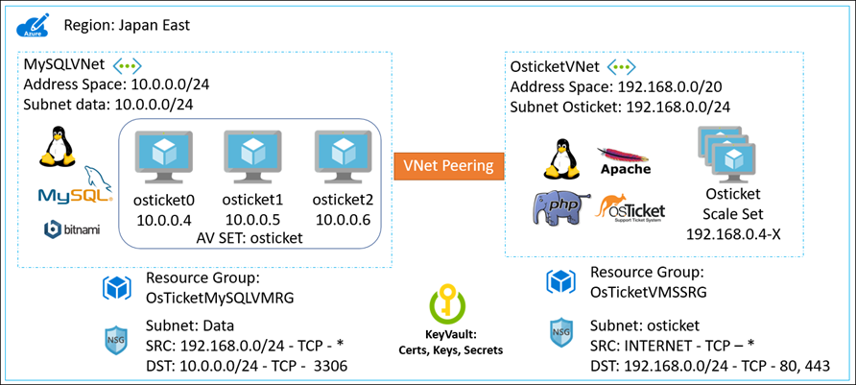
Preferred solution: Phase I

Slide 23
Preferred solution: Phase I
Solution overview
Azure IaaS using VM scale sets connected to a MySQL cluster running on Virtual Machines.
Isolated virtual networks peered together and secured using network security groups.
Application deployment
VM Scale Sets deployed using ARM Templates.
Linux Custom Script Extension to configure VMs and install the help desk application from a zip file.
Database migration
Manual backup and restore of the data using MySQL Workbench.
One-time process with zero data loss.

Slide 24
Preferred solution: Phase I – continued
KeyVault
HSMs used to create keys, certs, and secrets.
MySQL Cluster VMs disks encrypted.
High-availability
VM Scale sets configured for auto-scale providing elastic scale out/in and fault tolerance.
Multi-node MySQL cluster in data tier with failover capability.
RBAC
On-premises Active Directory will be synchronized with Azure AD and DCs deployed into IaaS.
Only administrators will have access to the resource groups they need based on least privilege.

Slide 25
Preferred solution: Phase I – continued
Azure Monitor
Azure Log Analytics will be leveraged for support and monitoring.
VMs will be updated using Azure Automation Update Management.
Azure Security Center will be leveraged to monitor for potential security issues.
Azure Automation will be trigged by a Web Hook from Log Analytics when known errors occur and to reboot impacted VMs using a Run Book.

Slide 26
Preferred solution: Phase I – networking
Hybrid cloud
ExpressRoute from Tokyo datacenter will be connected to Azure Japan East Region.
S2S VPN will be deployed as a failover backup.
Total of three virtual networks: IT Network, MySQL, and VM Scale Sets.
ExpressRoute will be connected to main IT Virtual Network with public and private peering established.
Network security groups will be implemented at the subnet Level to ensure that only traffic that is desired will be allowed.

Slide 27
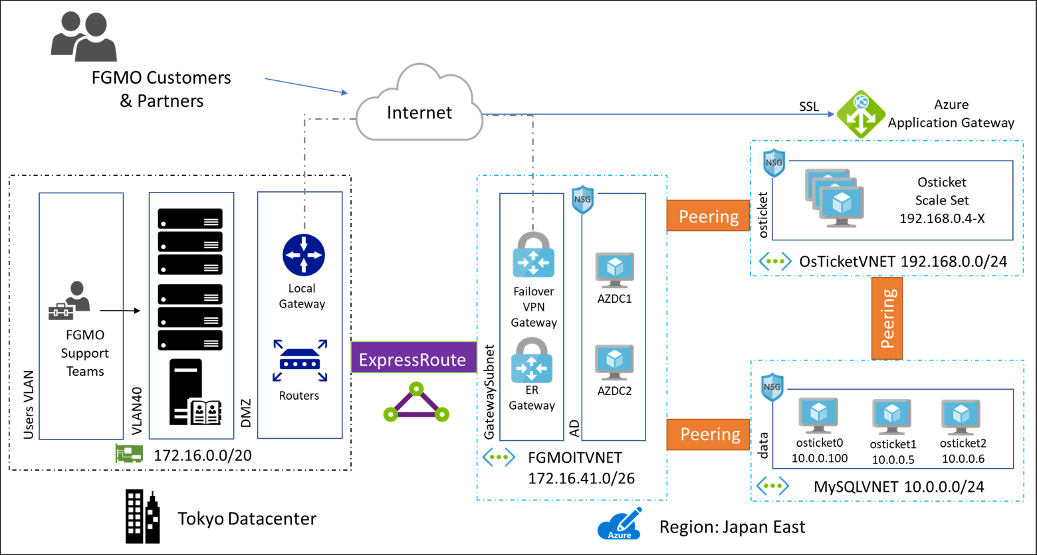
Preferred solution: Phase I – networking

Slide 28
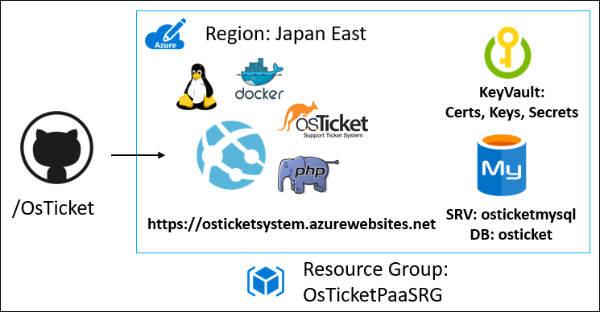
Preferred solution – Phase II

Slide 29
Preferred solution – Phase II
Solution overview
Azure PaaS using Azure App Service (Web App) and Azure Database for MySQL.
One IT Virtual Network connected via ExpressRoute with public peering.
Application deployment
Continuous deployment using GitHub.
Database migration
Manual backup and restore of the data using MySQL Workbench.
One-time process with zero data loss.

Slide 30
Preferred solution: Phase II – continued
KeyVault
HSMs used to create keys, certs and secrets.
MySQL Server connections using SSL enforced and data encrypted.
High-availability
App Service with autoscaling.
PaaS MySQL with auto failover (scaling is manual with down-time).
RBAC
On-premises Active Directory will be synchronized with Azure AD and DCs deployed into IaaS.
Only administrators will have access to the resource groups they need based on least privilege.

Slide 31
Preferred solution: Phase II – continued
Monitoring
Log Analytics and Azure Automation will be used to manage the web app.
App Service diagnostic data sent to Azure Storage account.
Custom search query will monitor for known error condition and will fire a Web hook to Azure Automation when event appears.
Azure Automation will restart web application to clear non-responsive web server.

Slide 32
Preferred solution: Phase II – networking
Hybrid cloud
ExpressRoute from Tokyo datacenter will remain connected to Azure Japan East Region.
S2S VPN will continue to be deployed as a Failover backup.
The MySQL and VM Scale Sets virtual networks will be retired and entire resource groups deleted.
ExpressRoute will continue to be connected to main IT Virtual Network leveraging only the private peering for this application.
Network security groups will be revised based on new configuration, ensure that only traffic that is desired will be allowed.

Slide 33
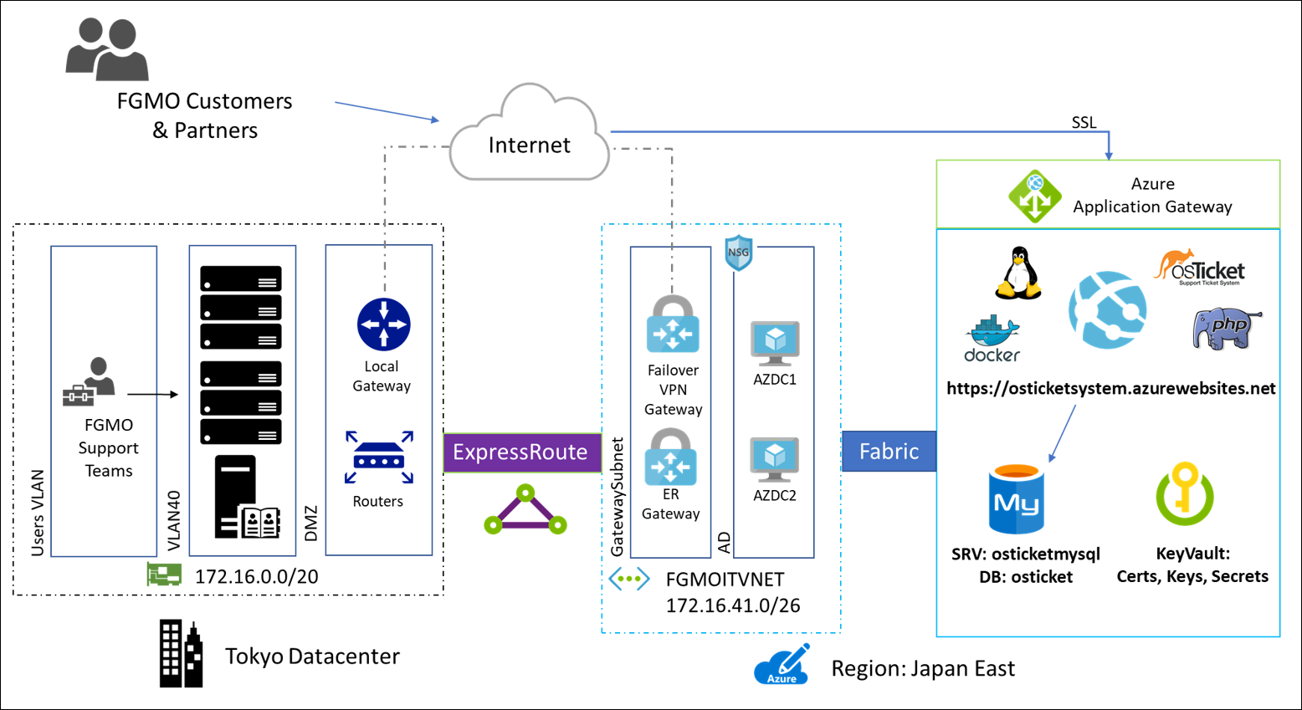
Preferred solution: Phase II – networking

Slide 34
Customer objections handling
FGMO has a detailed support history of their client’s environments. This information cannot be lost during the migration. Any data loss would be considered a migration failure.
Potential Answer:
Using the MySQL Workbench application, direct database exports and imports will allow for zero data loss during the transition to both the IaaS and PaaS phases of the migration to Azure.

Slide 35
Customer objections
FGMO’s data needs to be encrypted at rest and in transit. The current system is not configured in this manor, but when moving to the cloud they need to ensure their clients privacy.
Potential Answer:
Using the Azure KeyVault, FGMO will be able to secure their environment. Keys can be created using hardware security modules which will secure their VMs. Data on the VMs will be encrypted using these keys. Azure Storage Service encryption will be used to ensure that the Azure Storage account data is encrypted.

Slide 36
Customer objections
There should be no single point of failure in the system once it is in the cloud
Potential Answer:
In both Phase I and II there will no longer be a single point of failure as there is on-premises. With the IaaS implementation in Phase I, the use of a MySQL cluster for the data tier and VM Scale Sets for the app tier ensures HA. Once moved over to PaaS for Phase II again each of these tiers are HA, but with much less care an maintenance from the FGMO administrators.

Slide 37
Customer objections
This is a mission critical system and FGMO needs to be sure that they have SLAs from the cloud provider. This SLA should be no less than 99.9%.
Potential Answer:
With the move to Azure, FGMO will be provided with the SLA that they desire for their cloud implementation. ExpressRoute has a 99.9% SLA for the network connectivity. The VMs and VM Scale Sets are implemented with availability Sets which provides a 99.95% SLA. The Azure for MySQL database comes with a 99.99% SLA. The Azure App Service provides a 99.95% SLA.

Slide 38
Customer objections
FGMO is ready for the cloud but would like to move forward in a conservative manor. They are looking for a phased approach with a move to IaaS and then to PaaS later.
Potential Answer:
This is understandable given that using the cloud for production applications is new for many organizations. Moving to IaaS first will provide for an easier learning curve for the organization. After this is well understood, a final move to PaaS will be the final step.

Slide 39
Customer quote
“With our move to the Azure, FGMO is positioned to continue to grow, control costs and ensure our service is always available to our support team.”
- General Manager Kato Takahashi

